Slide 1
Computer Simulation
Module 1: Intro + Course Tour
Dave Goldsman, Ph.D.
Professor
Stewart School of Industrial and Systems Engineering
Whirlwind Tour – History

Slide 2
Lesson Overview
Last Time: Talked about modeling and introduced simulation.
This Time: Let’s talk history. Talk history. (History repeating itself.)
Simulation has been around a long time, but has really come into its own with the rise of the machines.

Slide 3
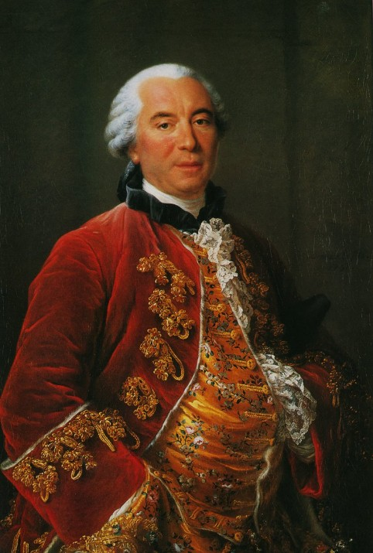
History
1777 – Buffon’s Needle Problem – a new spin on things

Slide 4
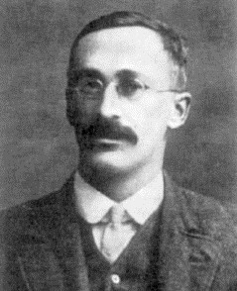
History
Early 1900’s – Beer and Student’s t distribution

Slide 5
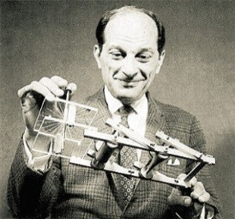
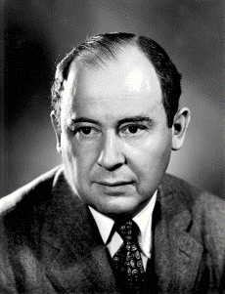
More History
1946 – Ulam, Metropolis, von Neumann, and the H-Bomb
1960’s – Industrial Applications
Manufacturing
Queueing Models

Slide 6
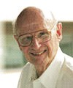
Recent History
Development of Simulation Languages
Easy-to-use modeling tools
Graphics
← Harry Markowitz
Rigorous Theoretical Work
Computational algorithms
Probabilistic and statistical methods

Slide 7
Origins: Manufacturing
Simulation is the technique of choice
Calculates movement of parts and interaction of system components.
Evaluates part flow thru the system.
Examines conflicting demand for resources.
Studies contemplated changes before their introduction.
Prevents design blunders.

Slide 8
Typical Questions
What will be the throughput?
How can we change it?
Where are the bottlenecks?
Which is the best design?
What is the reliability of the system?
What is the impact of breakdowns?

Slide 9

Summary
You can take your seat belts off… the history lesson is over!
Next Time: What kinds of stuff is simulation used for?

Slide 10
Computer Simulation
Module 1: Intro + Course Tour
Dave Goldsman, Ph.D.
Professor
Stewart School of Industrial and Systems Engineering
What Can We Do For You?

Slide 11
Lesson Overview
Last Time: Discussed the history of simulation.
This Time: What kinds of stuff is simulation used for?
I’ll give away the punch line: Simulation can be used for an amazing array of different applications.

Slide 12
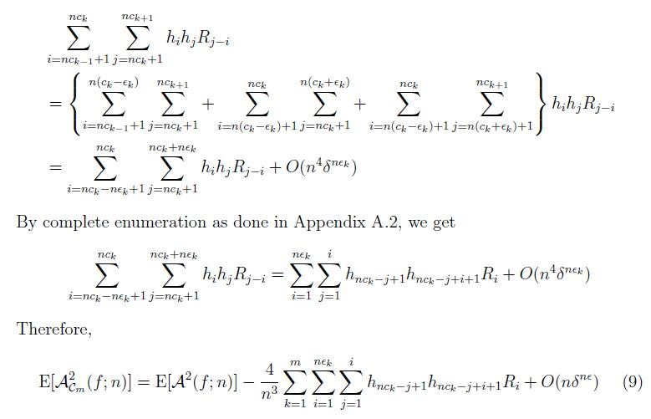
What I Used to Think Simulation Was

Slide 13
Actual Applications
Manufacturing
Automobile Production Facility
Carpet Production Facility
Queueing Problems
Call Center Analysis
Fast Food Drive-Thru
Fast Food Drive-Thru Call Center
Airport Security Line

Slide 14
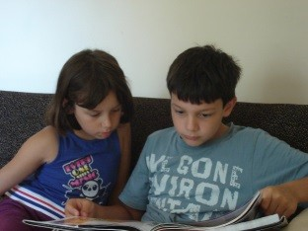
Some Queueing Systems
Ice Cream Shoppe
Combination meat processing center / fast-food restaurant / amusement park
← Denis (8) and Mina (6)

Slide 15

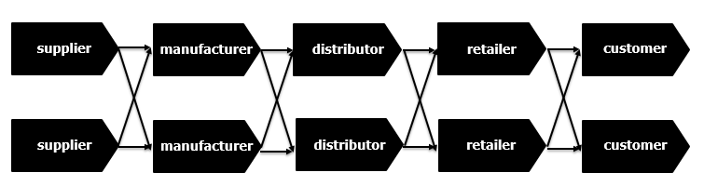

Generic Supply Chain
Think of supply chain as a network where any node can potentially connect to any other node.
In order to be lazy, let’s have things flow from left to right. Looks a bit like a flowchart, eh?

Slide 16
Supply Chains (cont’d)
1985: Professor and CEO of SC company: “Why would anyone want to simulate a SC?”
Now: Many SC tools with simulation capability.
Use simulation to determine how much value-added a forecasting application provides.
Use simulation to analyze how SC randomness or model errors affect a proposed solution. Is it robust? What’s the best solution?
Notes:
The flaw of averages - if you use averages too much - your results are going to be non-realistic because they don't take into account variability.

Slide 17
More Applications
Inventory and Supply Chain Analysis
Financial Analysis
Portfolio Analysis
Options Pricing
Traffic Simulation
Airspace Simulation
Service Sector
Health Systems

Slide 18
Health Systems
Patient Flow in a Hospital
Hospital Room Allocation
Optimization of Doctor / Nurse Scheduling
Procurement of Supplies
Disease Surveillance
Propagation of Disease Spread
Humanitarian Logistics

Slide 19
Surveilance Application
Use simulation to monitor certain time series.
Predict issues as or before they happen.
Is a disease in the process of becoming an outbreak?
When is something out of the ordinary occurring?
Take advantage of HUGE data sets.
Notes:
Has something happened in your time series?

Slide 20
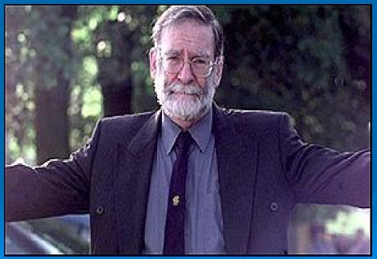

Who’s Mr. Handsome?

Slide 21
Dr. Harold Shipman
Killed his patients using heroin overdoses (#2 UK serial killer).
Caught after carelessly revising a patient’s will, leaving all her assets to himself (don’t use your own typewriter next time, dummy).
Doctored his records to show his patients had needed morphine. But the software recorded the dates of these modifications.
Hung himself in prison, never confessed.

Slide 22
Simulation Can Help!
Surveillance uses sequential hypothesis tests, where the null hyp H₀ is “no disease” (“no murder”).
The test statistics have very difficult distributions, even under H₀.
Use simulation to approximate the probability distributions of the statistics under the null hyp.
If sampling casts doubt on this distribution, then reject.

Slide 23
Summary
Looked at a wide variety of practical simulation applications.
Next Time: We’ll give some very easy examples of the actual use of simulation in simple settings.

Slide 24
Computer Simulation
Module 1: Intro + Course Tour
Dave Goldsman, Ph.D.
Professor
Stewart School of Industrial and Systems Engineering
Some Baby Examples

Slide 25
Lesson Overview
Last Time: Gave high-level examples of the kinds of stuff simulation is used for.
This Time: Some very easy examples of the use of simulation in simple settings.
The idea here is to start us off on our simulation journey via some really simple problems.

Slide 26

Happy Birthday
How many people do you need in a room in order to have a 50% chance that at least two will have the same birthday?
9
23
42
183

Slide 27
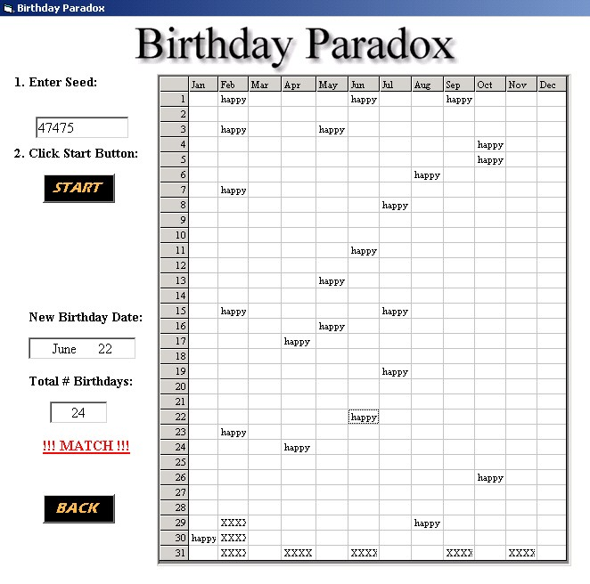

Slide 28
Let’s Make Some Pi
Use simulation to estimate π.
Idea:
Area of a unit square is 1.
Area of an inscribed circle is π/4.
Probability that a dart thrown at the square will hit the circle is π/4.
Throw lots of darts. Proportion that will land in circle should approach π/4.
Bonus Quiz: What is the volume of a pizza with radius z and height a?

Slide 29
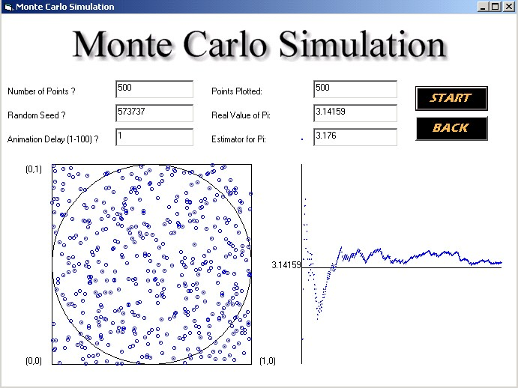
Yesterday, −1 2% Σ π, and it was really tasty!

Slide 30
Fun With Calculus
Use simulation to integrate f(x) = sin(πx) over [0,1].
Idea:
Sample n rectangles.
Each is centered randomly on [0,1] and has width 1/n and height f(x).
Add up areas.
Make n really, really big.
Sum of areas approaches the integral of f(x).

Slide 31
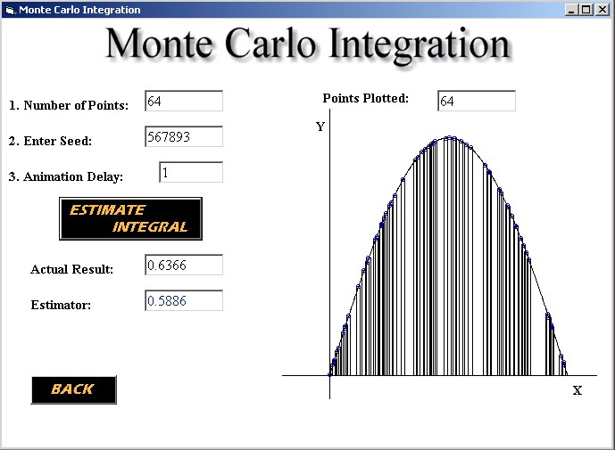

Slide 32
Summary
Looked at some easy examples of the use of simulation applications in simple settings.
Next Time: More more more! How do you like it? How do you like it?

Slide 33
Compu ter
_{S}Mo_{i}d_{m}ule_{u}1_{l}: I_{a}nt_{t}r_{i}od_{o}u_{n}ction +
Whirlwind Tour
Dave Goldsman, Ph.D.
Professor
Stewart School of Industrial and Systems Engineering
More Baby Examples

Slide 34
Lesson Overview
Last Time: Some baby examples.
This Time: More baby examples.

Slide 35
Evil Random Numbers
See what happens when you use a bad random number generator.
Idea:
Simulate heights vs weights.
Should be a 2-D bell curve (normal distribution) with most observations in the middle and some on the outside.
Do observations “look” random?

Slide 36
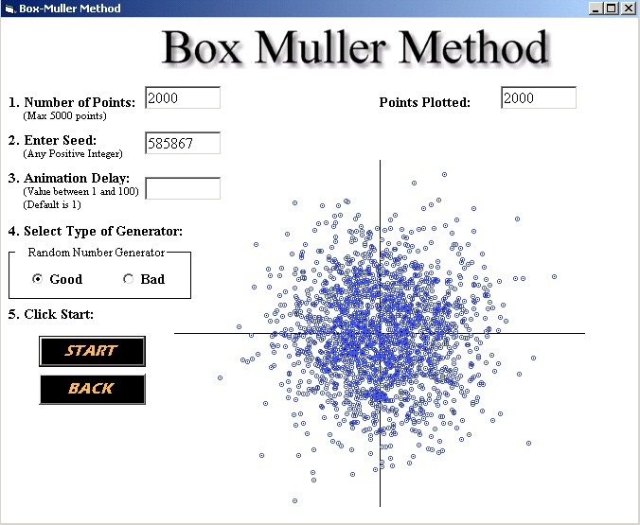
Good Dawg!

Slide 37
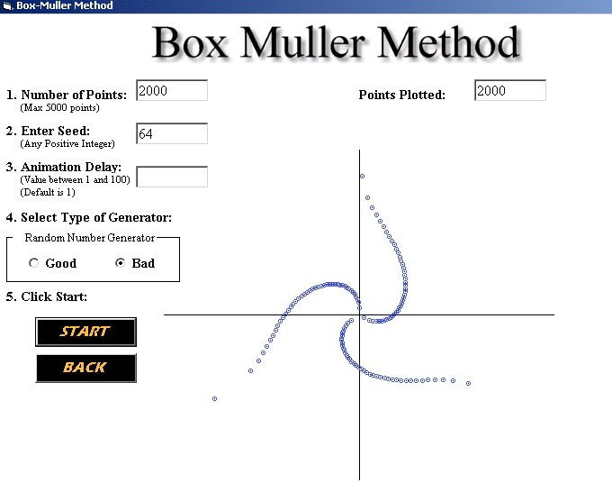
Bad Dawg!

Slide 38
Queues ‘R Us
Single-server queue at McWendy’s.
Customers show up, wait in line, get served first-in-first-out.
What happens as arrival rate approaches service rate?
Nothing much?
Line gets pretty long?
Hamburgers start to taste better?

Slide 39
Queues ‘R Us (cont’d)
Can analyze queues via simulation.
Can analyze via numerical or exact methods.
Fun fact: Notice anything interesting about the word “queueing”? How about “queueoid”?

Slide 40
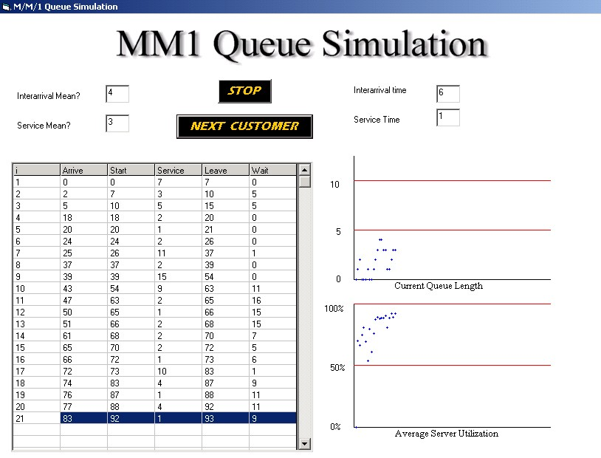
Notes:
M - stands for markov.
Interarrival means - around how long for a customer to come in.
Service - around how long for a customer to get served.
MM1 - the first M is what kind of interraval it is,, second M is what kind of service it is, and the 1 or whatever number is how many servers there are.

Slide 41
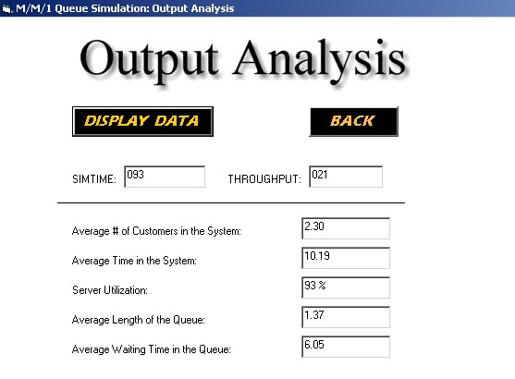

Slide 42
Stock Market Follies
Simulate a portfolio of various stocks.
Stock prices change randomly from year to year, with various volatilities.
Can consider different mixes for portfolio.
Simple spreadsheet application.

Slide 43
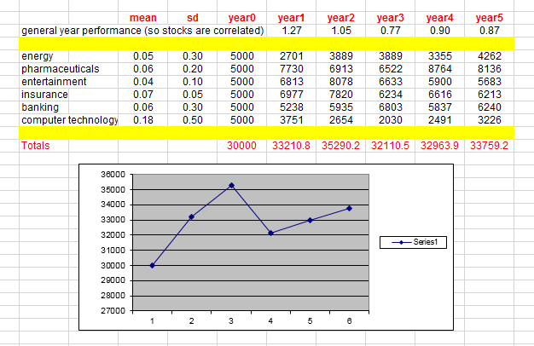

Slide 44
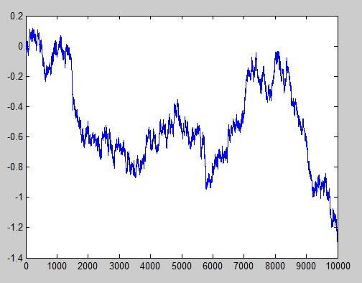
Taking a Random Walk
Take a normal step up or down every time unit and plot where you are as time progresses.
This “random walk” converges to Brownian motion.
Einstein and Black+Scholes won Nobel Prizes for this research.

Slide 45
Summary
We ran simulations on more easy examples, all of which involved randomness.
Next Time: Let’s generate that randomness on a computer!

Slide 46
Compu ter
_{S}Mo_{i}d_{m}ule_{u}1_{l}: I_{a}nt_{t}r_{i}od_{o}u_{n}ction +
Whirlwind Tour
Dave Goldsman, Ph.D.
Professor
Stewart School of Industrial and Systems Engineering
Generating Randomness

Slide 47
Lesson Overview
Last Time: Presented some really simple baby examples of simulations, all of which used some sort of randomness.
This Time: So how can we generate that randomness?
The big reveal: The algorithms that generate “randomness” aren’t random at all! They just appear to be to you and me.

Slide 48
Randomness
Need random variables (RV’s) to run the simulation, e.g., interarrival times, service times, etc.
Generate Unif(0,1) pseudo-random numbers (PRN’s)
Use a deterministic algorithm
Not really random, but seem to be
Generate other RV’s
Start with Unif(0,1)’s
Apply transformations to get any other type of random variable

Slide 49
Unif(0,1) PRN’s
Deterministic algorithm
Example: Linear Congruential Generator
Choose an integer “seed,” X(0)
Set X(i) = a X(i-1) mod(m), where a and m are carefully chosen constants, and mod is the modulus function
Set the ith PRN as U(i) = X(i)/m

Slide 50
Unif(0,1) PRN’s
Pretend Example:
Start with X(0) = 4 (for no reason)
Set X(i) = 5 X(i-1) mod(7
– Then X(1) = 20 mod 7 = 6
– X(2) = 2, X(3) = 3, X(4) = 1, X(5)
= 5, etc.
– So U(1) = X(1)/m = 6/7
– U(2) = 2/7, U(3) = 3/7, etc.
Numbers not so random.

Slide 51
Unif(0,1) PRN’s
Real Example
X(i) = 16807 X(i-1) mod(2³¹ -1)
U(i) = X(i) / m
This generator is used in a number of simulation languages
Has nice properties, including long “cycle times”
Better generators are out there

Slide 52
Generating Other RV’s
Start with U(i) ~ Unif(0,1)
Apply some appropriate transformation
Example: -(1/λ) ln(U(i)) ~ Exp(λ)
Inverse transform method – can use this for various important distributions
Many other more-sophisticated methods available, e.g., Box- Muller method for normals

Slide 53
Summary
Showed how to generate appears to be randomness on a computer!
Next Time: Random input means random output. Trouble with a Capital T. What to do?

Slide 54
Compu ter
_{S}Mo_{i}d_{m}ule_{u}1_{l}: I_{a}nt_{t}r_{i}od_{o}u_{n}ction +
Whirlwind Tour
Dave Goldsman, Ph.D.
Professor
Stewart School of Industrial and Systems Engineering
Simulation Output Analysis

Slide 55
Lesson Overview
Last Time: How can we generate that randomness so as to run the simulation?
This Time: Random input means random output, which requires careful analysis. What can we do about that?
Bottom Line: Everything that taught you in your Baby Stats class is a big fat lie – simulation output is never independent and normal. So we’ll need new methods.

Slide 56
Analyzing Randomness
Simulation output is nasty. Consider consecutive customer waiting times.
Not normally distributed – usually skewed
Not identically distributed – patterns change during the day
Not independent – usually correlated
Can’t analyze via “usual” statistics methods! Trouble!

Slide 57
Analyzing Randomness
Two general cases to consider
Terminating Simulations
Interested in short-term behavior
Example: Avg customer waiting time in a bank over the course of a day
Example: Avg # of infected victims during a pandemic
Steady-State Simulations
Interested in long-term behavior
Example: Long-running assembly line

Slide 58
Terminating Simulations
Usually analyzed via Independent Replications
Make independent runs (replications) of the simulation, each under identical conditions
Sample means from each replication are assumed to be approximately i.i.d. normal
Use classical statistics techniques on the i.i.d. sample means (not on the original observations)

Slide 59
Steady-State Simulations
First deal with initialization (start- up) bias.
Usually “warm up” simulation before collecting data
Failure to do so can ruin statistical analysis
Many methods for dealing with steady-state data
Batch Means
Overlapping Batch Means / Spectral Analysis
Standardized Time Series
Regeneration

Slide 60
Steady-State Simulations
Method of Batch Means
Make one long run (vs. many shorter reps)
Warm up simulation before collecting data
Chop remaining observations into contiguous batches
Sample means from each batch are approximately i.i.d. normal
Use classical statistics on the
i.i.d. batch means

Slide 61
Summary
Talked about analysis of troublesome simulation output.
This completes Module 1, which went over introductory material to get us salivating for more!
Coming up: Module 2 will present lots of calc/prob/stats review material from your distant past, albeit it with a little bit of simulation thrown in.

